Slide 1

2026 University of California Open Enrollment
October 30 – November 21, 2025

Slide 2

Why Health Net?
CHOOSE UC BLUE & GOLD FOR 2026!
Affordable premiums, $0 deductible/fixed or predictable copays
Broad choice of providers - including all UC medical centers and physician groups
Teladoc Telehealth appointments available 24/7 for $0 copay
Eat Right Now© - Mindful Eating, Weight Loss and Diabetes Prevention
Dedicated Health Benefit Navigators – personalized navigation for high-touch service
Confidential and Proprietary Information
2

Slide 3



What’s new for 2026? - UC Blue & Gold Benefits
What’s Changing
Find a Provider (FAP) Tool available 9/25/2025
The new tool replaces Provider Search
Enhanced Infertility Coverage
Infertility services will be covered at plan-specific cost share
IVF, ZIFT, and GIFT: Three completed oocyte retrievals per lifetime and unlimited transfers per member
Infertility drugs covered at plan-specific cost share
Infertility services and drugs will apply to out-of-pocket maximum
Weight Loss Rx Change
Access to new prescriptions for weight loss including GLP-1s will be limited to members with severe obesity who have a body mass index (BMI) of 40 or greater and meet Health Net Prior Authorization coverage requirements
Confidential and Proprietary Information
3

Slide 4
2026 Coverage Overview
Covered Services
You Pay
Preventive Care (Screenings and immunizations) | $0
Doctor and Specialist Office Visits (Medical) | $30 copay
Hospitalization (Medical) | $250 copay per admission
24/7 Virtual Care – Telehealth visits through Teladoc | $0
Urgent Care | $30 copay
Emergency care (Medical) | $125 copay (waived if admitted)
X-ray and Lab Procedures | $0
MinuteClinic | $30 copay (if preventive: $0)
Chiropractic/Acupuncture | $20 copay (24 visits combined max per calendar year)
Infertility Services and drugs (IVF, ZIFT, GIFT) | Covered at plan-specific cost share. Three completed oocyte retrievals per lifetime and unlimited transfers per member
4

Slide 5
2026 Coverage Overview (cont’d)
Covered Services
You Pay
Maternity Care | $0 for all services except hospital stays for which the hospital copay applies
Outpatient Surgery | $100 copay
Ambulance Emergency Transport (Medical) | $0
Prescription Drugs* • Retail (30-day supply) • Mail order or walk-up services available at UC Medical Centers and CVS Pharmacies (90-day supply) • Specialty drugs (Up to a 30-day supply) | $10 generic; $30 brand formulary when a generic in not available; $50 non-formulary $20 generic; $60 brand formulary; $100 non-formulary 30% up to $150 maximum per prescription
*Without prior authorization from Health Net, there is no coverage for brand name drugs when a generic equivalent is available. If it is medically necessary for a member to take a brand name medication when a generic
equivalent is available, the copay will be covered at Tier 3 ($50 for a 30-day supply, $100 for a 90-day supply).
5

Slide 6
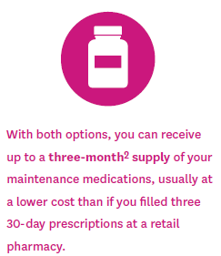
Mail Service Pharmacy™ and Maintenance Choice® Program¹
Two options – one choice for convenience!
The mail order program gives you two options for filling and refilling your three-month² maintenance prescriptions:
1. The Maintenance Choice program at a CVS Pharmacy®
Advantages of a CVS Pharmacy retail location:
Pick up your medications directly from the pharmacy at a time that is convenient for you.
Same-day prescription availability.
Talk face to face with a pharmacist.
2. The Mail Service Program through the CVS Caremark® Mail Service Pharmacy³
Advantages of the CVS Caremark Mail Service Pharmacy:
Convenient home delivery.
Receive your medications in confidential, tamper-resistant and (when necessary) temperature-controlled packaging.
Have questions? Talk to a pharmacist by phone.
¹Not all plans offer Maintenance Choice; please check your health coverage document to see which programs are available to you.
²Actual quantity may vary depending on your plan. Check with the pharmacy for coverage of specific prescription drugs.
³For either option, you may be responsible for a copayment. See the prescription drug coverage details of your health plan for copayment information in your health coverage document.
6

Slide 7




Health Net Behavioral Health
Health Net provides behavioral health (i.e., mental health and substance use disorder) benefits to UC Blue & Gold members
Behavioral health benefits are integrated with medical benefits
For standard outpatient care (i.e., therapy or medication management) no referral is needed
For certain services (e.g., psychological testing, residential treatment, intensive outpatient, Applied Behavior Analysis, etc.), authorization is required
Call Customer Service at 800-663-9355 Monday-Friday, 8:00 a.m. to 8:00 p.m. PT
A Customer Service Representative will assist if you'd like help finding a provider with availability. Health Net will outreach to providers on your behalf and will contact you with the soonest appointment available.
Please Note: routine appointments with an MD/psychiatrist may take up to 15 business days, and an appointment with a therapist may take up to 10 business days.
7

Slide 8
2026 Behavioral Health Benefits
Covered Services
You Pay
Behavioral Health/Substance Abuse Office Visits | Visits 1-3: $0 Visits 4+: $30 copay
Hospitalization (Behavioral health) | $250 copay per admission
24/7 Virtual Care – Telehealth visits through Teladoc (Behavioral health) | $0
Emergency care (Behavioral health) | $125 copay (waived if admitted)
Ambulance Emergency Transport (Behavioral health) | $0
Other Behavioral Health Outpatient Services • Psychological testing, outpatient electroconvulsive therapy, extended-length therapy sessions, biofeedback, Applied Behavior Analysis (ABA), methadone maintenance • Structured/intensive outpatient program treatment • Partial hospitalized/day treatment | $0
8

Slide 9
Enhanced Infertility Benefits
Limited Services (partial coverage) | Cost
Artificial Insemination | Covered at plan benefits²
In Vitro Fertilization (IVF) | Covered at plan benefits limited to a combined 3 completed oocyte retrievals per lifetime and unlimited transfers, per member
Zygote Intrafallopian Transfer (ZIFT) | Covered at plan benefits limited to a combined 3 completed oocyte retrievals per lifetime and unlimited transfers, per member
Gamete Intrafallopian Transfer (GIFT) | Covered at plan benefits limited to a combined 3 completed oocyte retrievals per lifetime and unlimited transfers, per member
Infertility Drugs¹ | Covered at plan benefits²
¹Infertility drugs are only provided in connection with covered services
²“Covered at plan benefits” indicates that the cost of the service will be applied to your plan’s standard cost-sharing (e.g., your copay for office visits, inpatient hospital stays, or prescription drugs).
9

Slide 10


Chiropractic and Acupuncture Program
QUALITY, AFFORDABLE COVERAGE WITHOUT NEEDING A REFERRAL
Acupuncture Care
Chiropractic Care
$20 per visit, up to 24* visits per calendar year
$20 per visit, up to 24* visits per calendar year
Initial examination, subsequent office visits, re-examination
$50 annual chiro appliance allowance
Musculoskeletal and related conditions
Sprain/strain injuries to the spine and extremities
Pain, including low back pain, post-operative pain
Musculoskeletal and related conditions
Musculoskeletal and related conditions
Carpal tunnel syndrome, headaches, tennis elbow
Inflammatory disorders, low pain syndromes
Inflammatory disorders, low pain syndromes
*Visit maximums are combined for acupuncture and chiropractic services
10
Notes:
Chiropractic and Acupuncture is a covered benefit under the UC Blue & Gold HMO plan. You get 24 combined visits at a $20 copayment per visit, per calendar year. You can self-refer to any provider associated with American Specialty Health

Slide 11


Teladoc – Telehealth Services ENJOY ACCESS TO TELEDOC VIRTUAL VISITS AT NO COPAY!
Teladoc Health Features:
24/7 on-demand and scheduled general medicine visits for all ages
Scheduled behavioral health visits as noted below
Psychiatry visits (18 years and older)
Telephonic & Video visits
Web-based visit option
Smartphone/tablet app
Out-of-state care while traveling or away at college
Prescriptions
11

Slide 12


MinuteClinic
GET CARE ON YOUR SCHEDULE
Located inside CVS/pharmacy stores Schedule an appointment online
Staffed by nurse practitioners and physician assistants Over 848 locations nationwide
No authorization/PCP referral needed Present Health Net ID card at the time of service
Convenient healthcare services Wellness and preventive care, minor illnesses/injuries, vaccinations
Low or no copayment Preventive care $0, all other services $30
12

Slide 13
Find a Provider

Slide 14
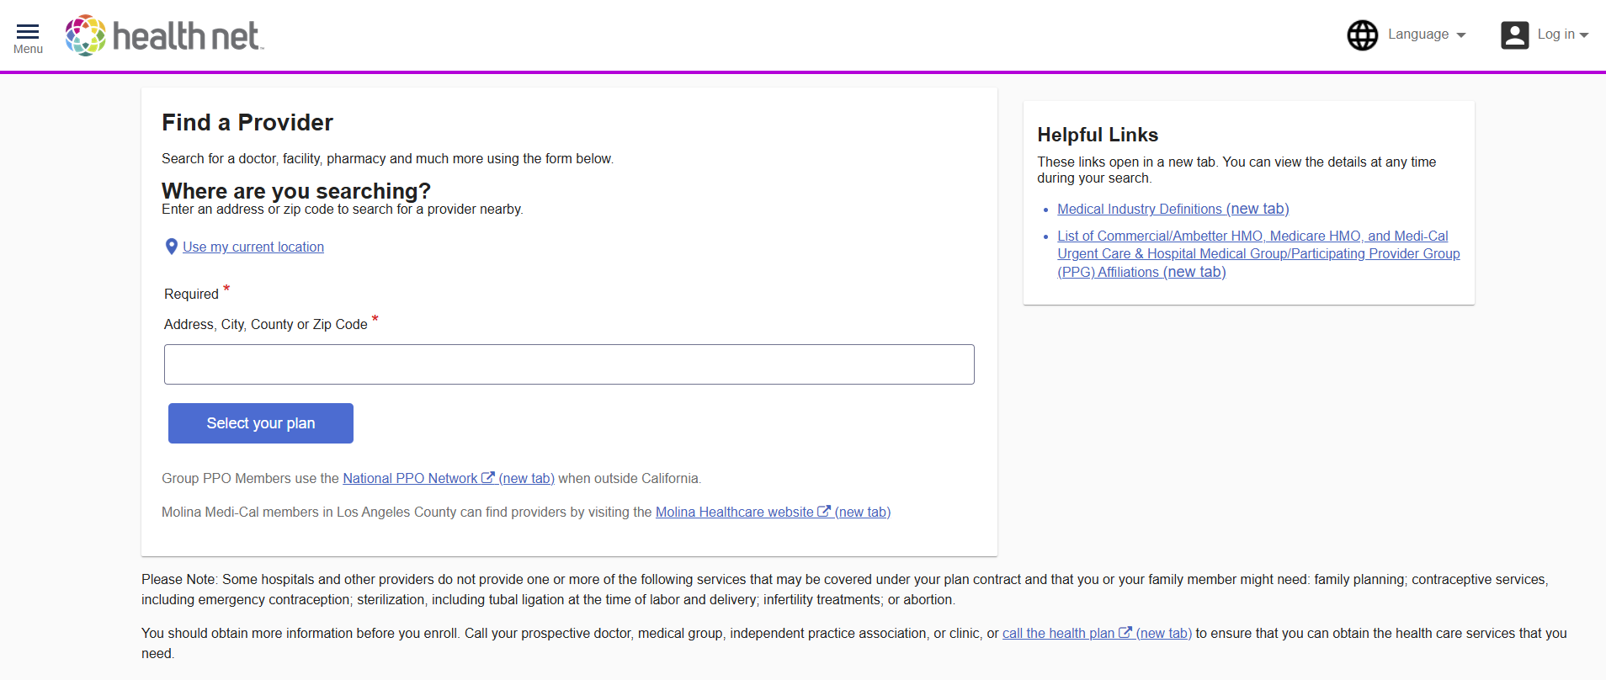
Find a Provider Main Screen
Users do not need to be logged into the member portal to access FAP.
Select the “Use my current location” option to detect your location based on your browser.
List of Commercial/Ambetter HMO, Medicare HMO, and Medi-Cal Urgent Care & Hospital Medical Group/Participating Provider Group (PPG) Affiliations.
Search by Address, City, County, or Zip Code.
Type value and select choice from drop down options.
Find reports displaying
PPG to Affiliated Urgent Care Centers
and PPG to Affiliated Hospitals.

Slide 15
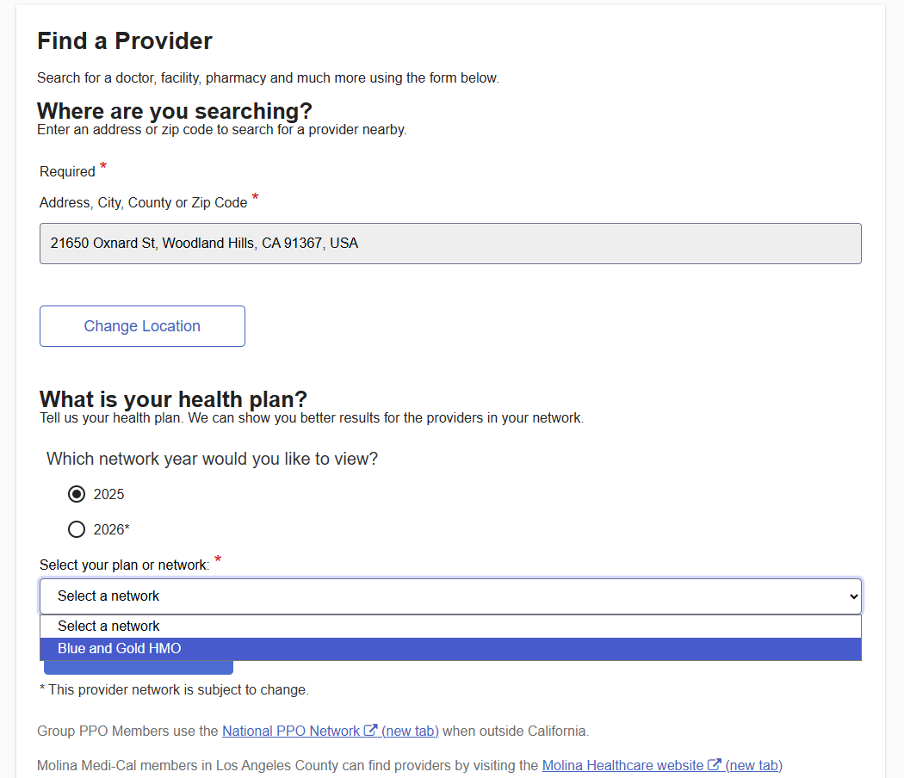
Find a Provider PLAN SELECTION
Selection of a Plan/Network is required.
Blue & Gold HMO network will be the only plan option for UC members through the custom microsite.

Slide 16
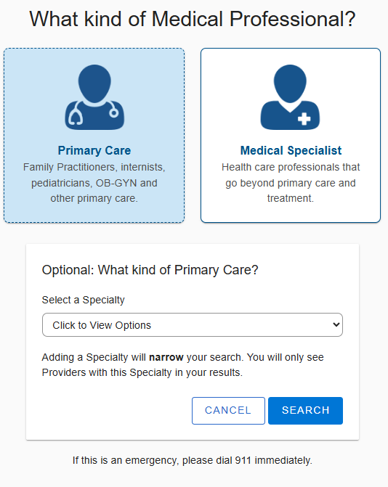
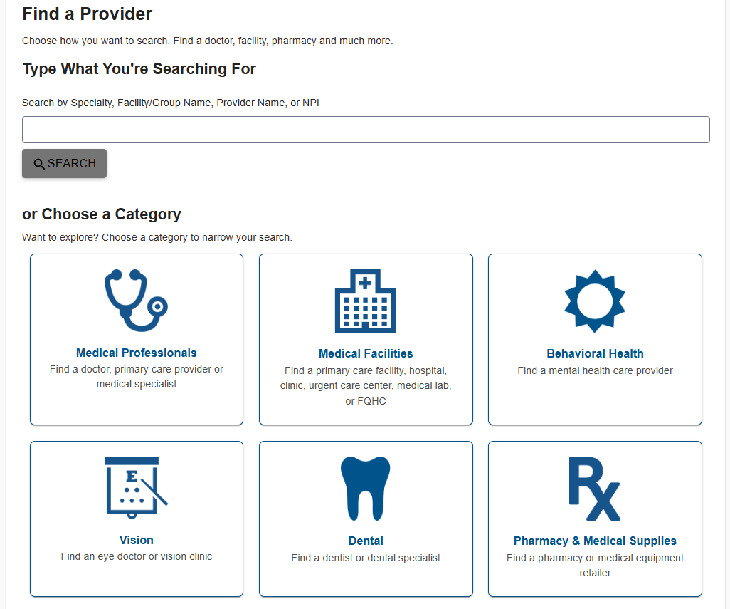
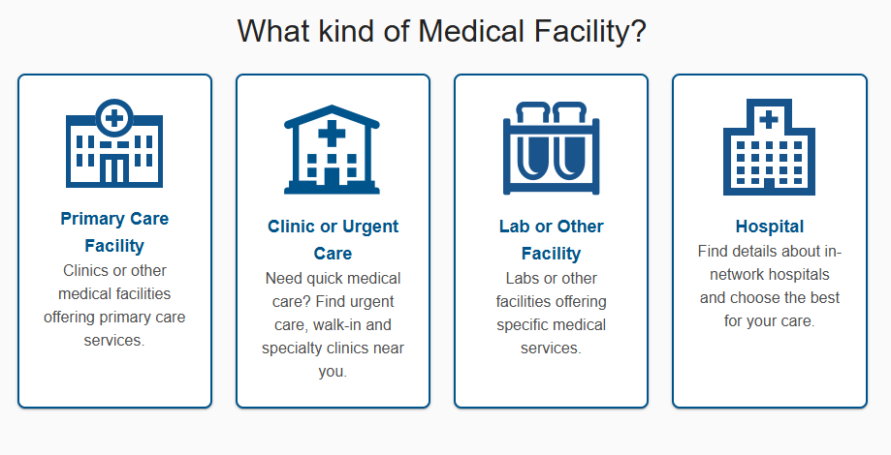
Find a Provider Search Bar & Provider Category Tiles
Search Bar
Category Tiles
Selection of a Specialty is optional.
You can advance to Search Results without selection a Specialty.

Slide 17
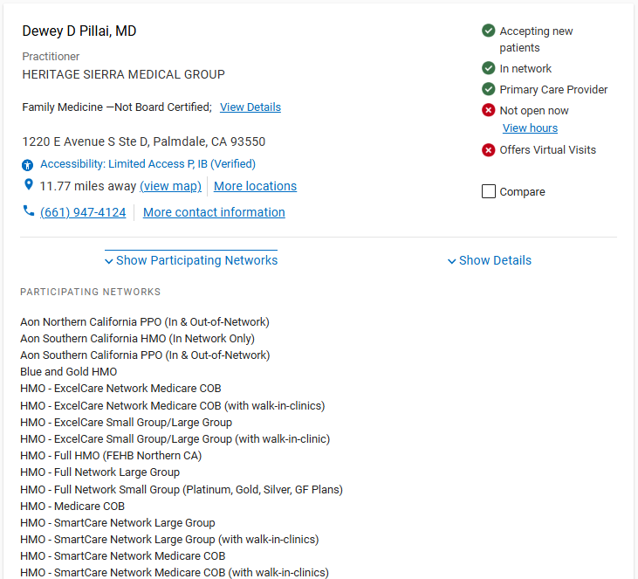
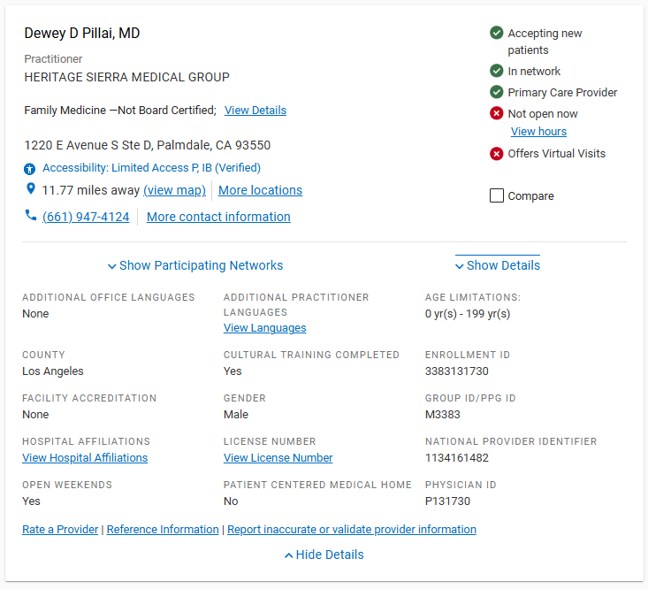
Provider Card medical professional Example
.

Slide 18
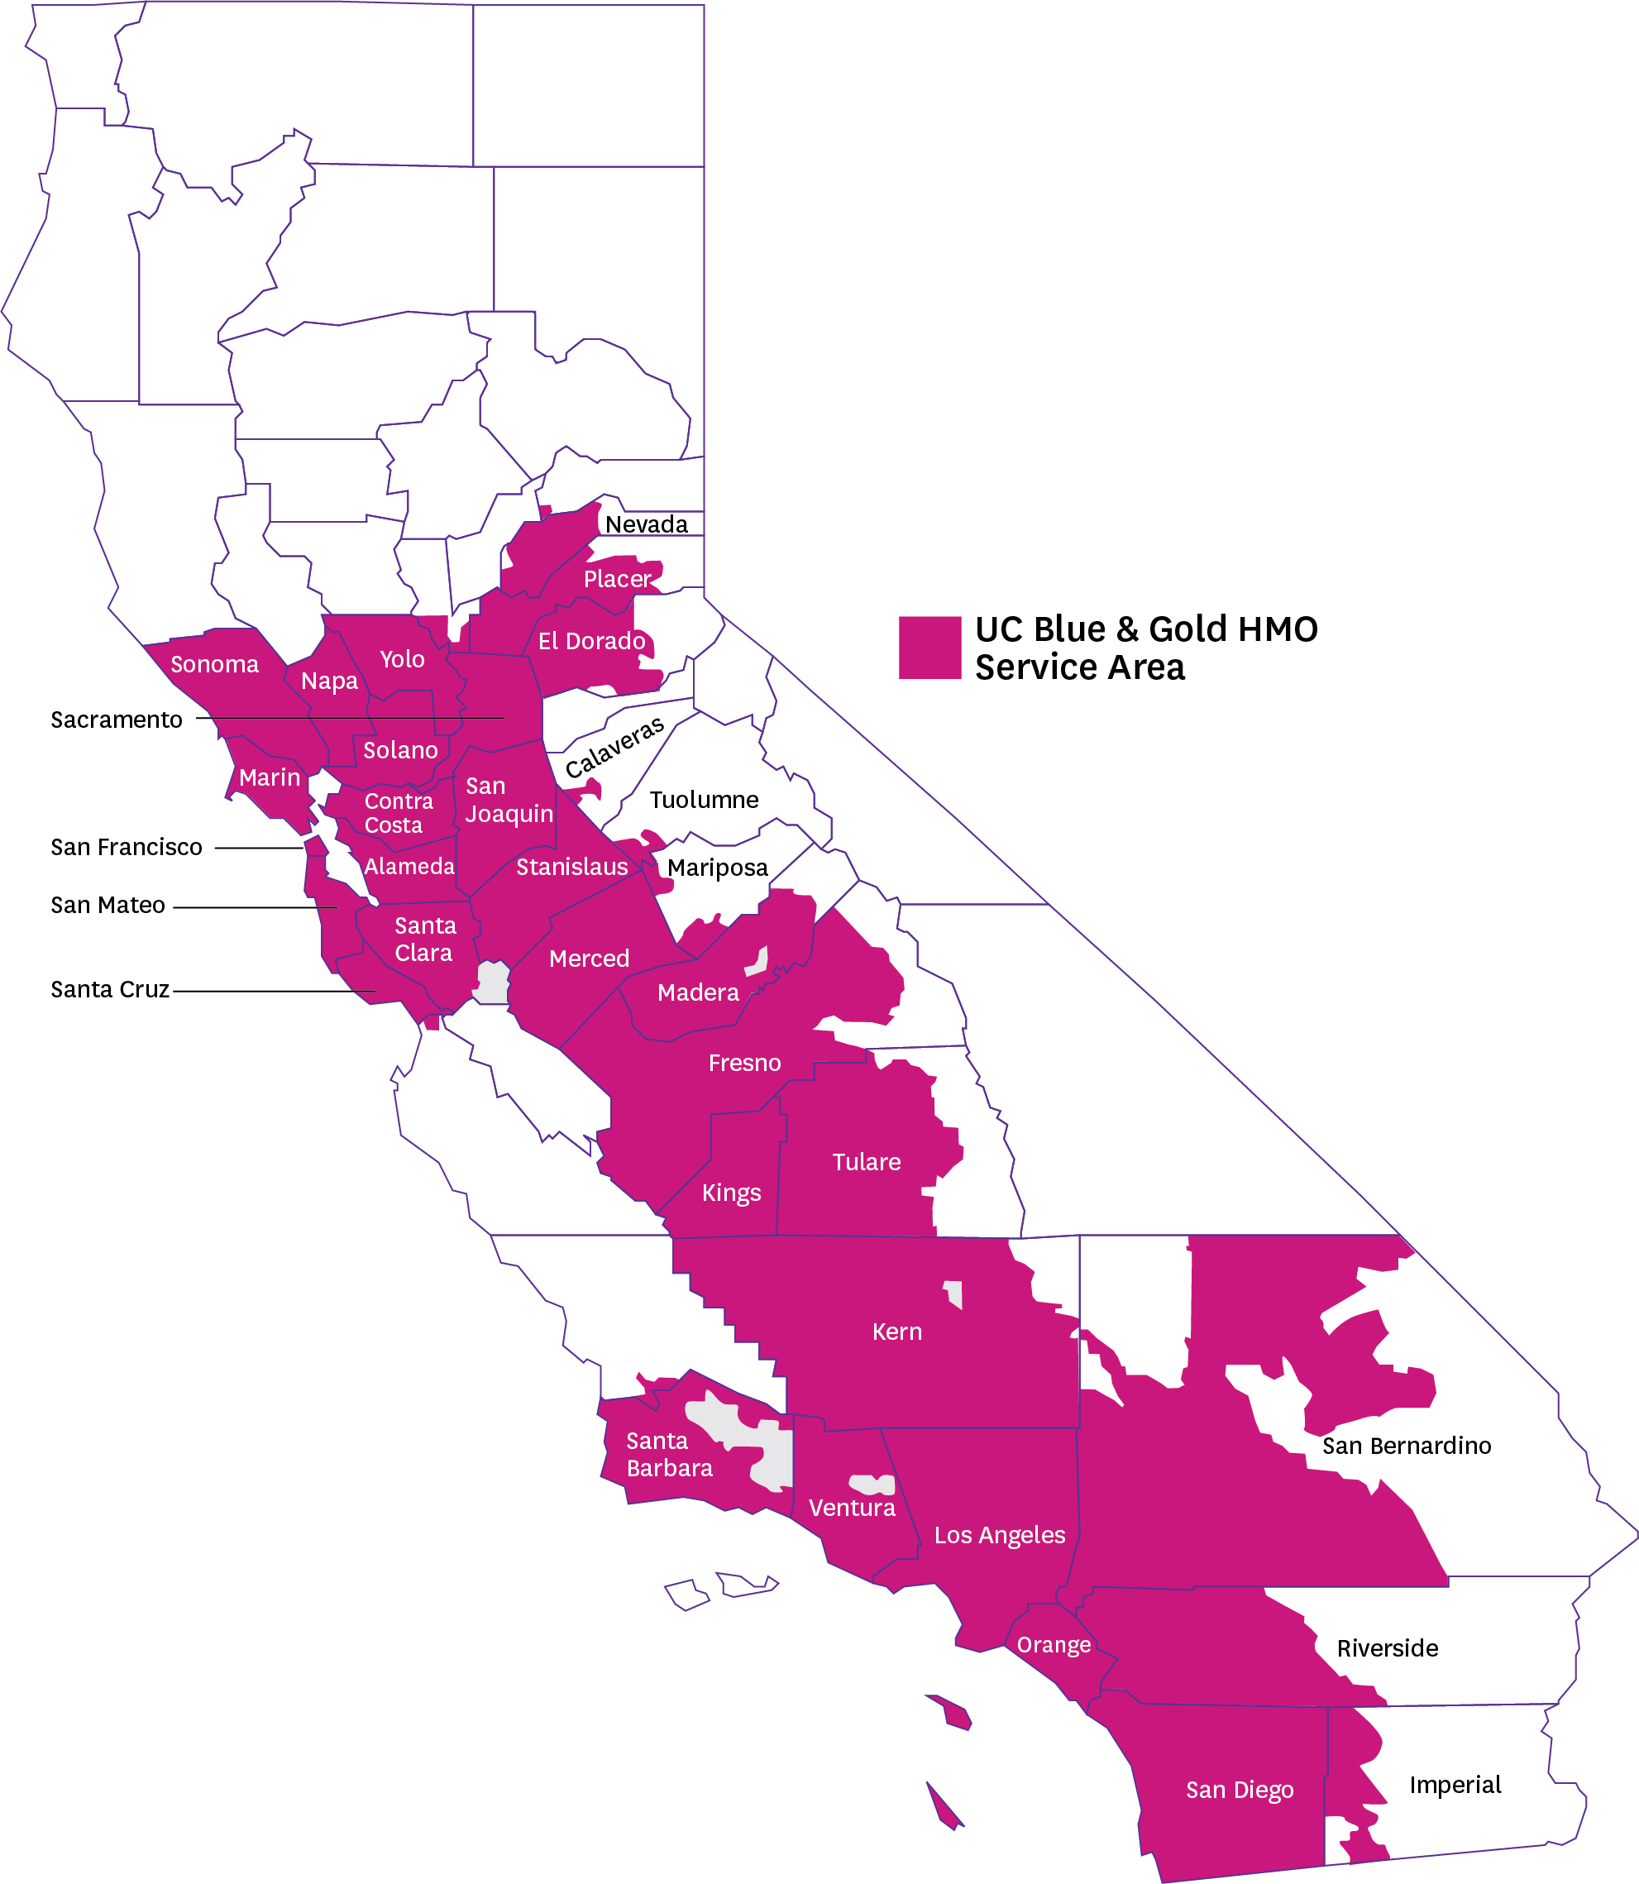
Top PPGs utilized in Riverside by UC B&G members:
Riverside Medical Clinic
Optum
UCI University Physicians & Surgeons
Regal Medical Group
18

Slide 19
Health Net Doula Program Doulas support the all-around needs of pregnant and postpartum persons
Doula Program Coverage
One visit with a doula to get to know each other.
Up to eight more visits that can happen during the pregnancy and postpartum.
Support during labor and birth.
Up to two, three-hour postpartum visits after the end of a pregnancy.
How you can find a Doula
Visit healthnet.com/uc > Find a Provider.
Enter a location (street address, city, county, or state) and click on Select your plan.
Select your health plan or network, Blue & Gold HMO and then
click Continue
Choose Medical Facilities, then Clinic or Urgent Care, then use the drop down to select a specialty of Doula.
19

Slide 20

Eat Right Now® by Sharecare Digital Weight Loss and Diabetes Prevention Program
Eat Right Now program offers digital therapeutic tracks for weight loss and diabetes prevention that combine mindful awareness with a science-based, step-by-step approach.
12-month program with CDC Diabetes Prevention curriculum
Multi-channel coaching with certified weight loss coaches
Wireless scale and activity tracker*
Science-based tools to manage cravings and build skills
Available in English and Spanish
For members 18+ years old
*Scale offered at no cost for members who qualify for and enroll in the program. Member must input mailing address and complete order to receive the scale. Promo code for no-cost activity tracker may be earned after member completes 10+ individual days of program engagement OR achieves 2.5% weight loss at least 30 days after enrollment.
20

Slide 21



Active & Fit Direct Fitness Discount Program
Members receive access to 12,700+ standard fitness centers nationwide
14,000+ digital workout video in the comfort of your home
Just $28/month fee, plus $28 enrollment fee + taxes (member funded)
Find out more at healthnet.com/uc (under Wellness Program) or activeandfitdirect.com to locate a fitness center near you.
Call Active & Fit at 844-646-2746 to enroll and to use code HNWELL
Free Guest Pass to try-out clubs (available at most centers)
Option to switch fitness centers at any time
Online fitness tracking from a variety of popular wearable devices, apps, and exercise equipment
21

Slide 22
Dedicated Health Benefit Navigators
PERSONALIZED NAVIGATION FOR HIGH-TOUCH SERVICE
Local Knowledge Dedicated teams based in SoCal & NorCal
Experience Expertise in UC benefits, ensure a high level of support
Education & Empowerment Motivating members to engage with their health outcomes
Holistic View of Member Integration of medical, behavioral health and pharmacy
Member Advocate Provides end-to-end support and service
Personalized Support
Addresses next best actions
HBN
Member
22

Slide 23
Get More Done Online at healthnet.com/uc
As a registered member of the website, you’ll have 24/7 access to the user-friendly tools and health information you need most. Here’s just a sample of all you can do:
What you can do online
Get your benefit details and copayments, Evidence of Coverage (EOC) or Summary of Benefits and Coverage (SBC).
Find a doctor, get ID cards and forms, manage your account details, and view medical treatment policies.
Get valuable discounts on health-related services and products.
Wellness and Value-Added Programs: Complete the RealAge® Test, participate in online health programs, track your health, and access online services 24 hours a day.
23

Slide 24



Contact Page
OUR FOCUS IS YOUR HEALTH
Health Benefit Navigators:
1-800-539-4072, Monday through Friday
8:00 a.m. to 8:00 p.m. PT
Behavioral Health Customer Service Team:
1-800-663-9355, Monday through Friday
8:00 a.m. to 8:00 p.m. PT
Email:
askblue&gold@healthnet.com for a response within 24-48 hours, Mon-Fri
Facebook:
facebook@HealthNetForUC
A website just for UC Blue & Gold members!
www.healthnet.com/uc
24

Slide 25
Thank you!

